Slide 1

Natural Language Processing of Text in
Legal Contracts for Structured Database Construction
Project for Orange Silicon Valley
Rafael V. Baca, Esquire
M.S. Data Science: GalvanizeU, University of New Haven
San Francisco, CA

Slide 2


GOAL:
– Recognize possible ambiguity with legal contracts
– Form understanding
for future development of automated contract drafting
TAKE AWAYS –
Legal NLP – Vague Words
Baseline – avoid risk of deviation while drafting contracts
1. Background – Orange – Project - Contacts
2. Data Structuring
3. Extraction – Environment - Steps 1-4+ - Output
4. Results
5. Conclusion – & Suggestions for future
AGENDA:

Slide 3

1. Background:
–29 countries
* 256 Million Customers:
Orange Silicon Valley R&D division of
rebranded French Telecom
Orange Silicon Valley interested in enhanced harmonization of :
Orange’s BUSINESS CONTRACTS – (the topic of this project)

Slide 4

Background: The Project
500+ Business Contracts
executed by – ORANGE
Paper Contracts
(since the 1990s)
scanned to pdf
50 – 100 pages
each
PDF:
Portable
Document
Format – a graphics file format
(i.e. image file)
Requires Optical Character Recognition to extract text

Slide 5
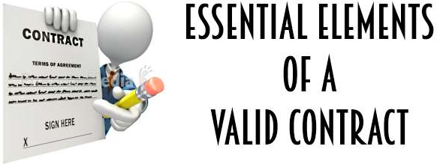

Background - CONTRACTS
In business practice - never std standard boilerplate template for what,
where, and to the extent provisions are placed within a written contract
Cumulative Effect: many Ks written ad hoc = inefficiency leading to
greater COSTS for legal dpt. & business units alike.
Arcane language in
legal documents
makes NLP parsing
very difficult given the present limitations of nlp tools -
MUST GAIN HARMONIZED UNDERSTANDING
OF THESE BUSINESS DOCUMENTS
Acceptance
Offer

Slide 6

DATA STRUCTURING
SEMANTIC meaning of legal documentation not often exacting BY DESIGN
Underlying baseline for entire project was manually developed by comparing to
an Orange Master Services Agreement template
as a metric for all other contracts within the corpus
To develop a hand-derived baseline of labels for comparison with
other contracts from the corpus:
SUBJECT matter Expert - applied the template & legal K requirements

Slide 7

EXTRACTION - Environment
ONLY HANDFULL of academic studies - infamous ambiguity associated with
Legal nlp & CONFIDENTIALITY = restricted access to contractual data
Clause labels = Min legally binding requirements
= Min std clauses commonly used
while conducting int’l business operations
Due to PDFMiner OCR limitations
subsequently migrated to a py2.7
shell environment
Pilot database - structured on a local
computer w/ toy dataset of public online business Ks
(2) Configure duplicate set -successful code and
Workflow then configured at firewalled,
Corporate VPN with corpus of Ks

Slide 8
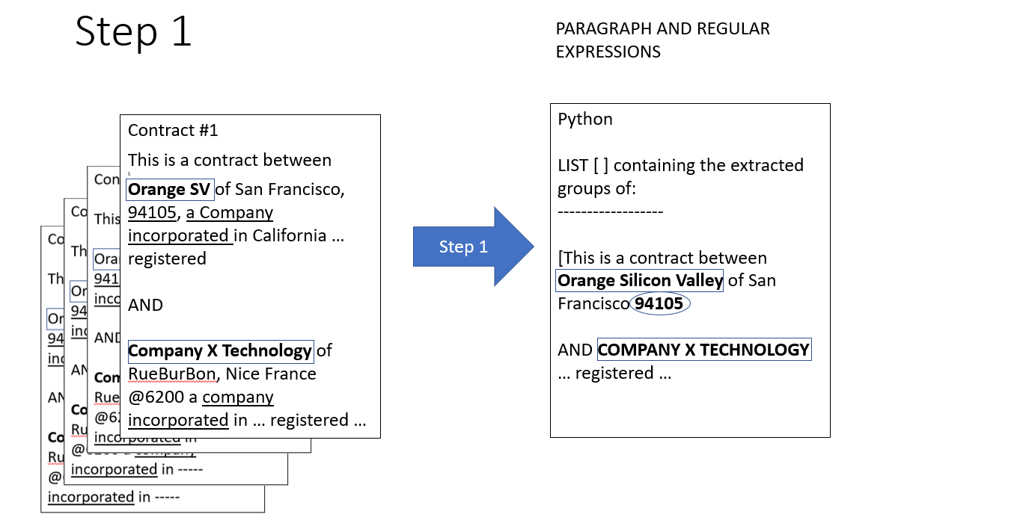
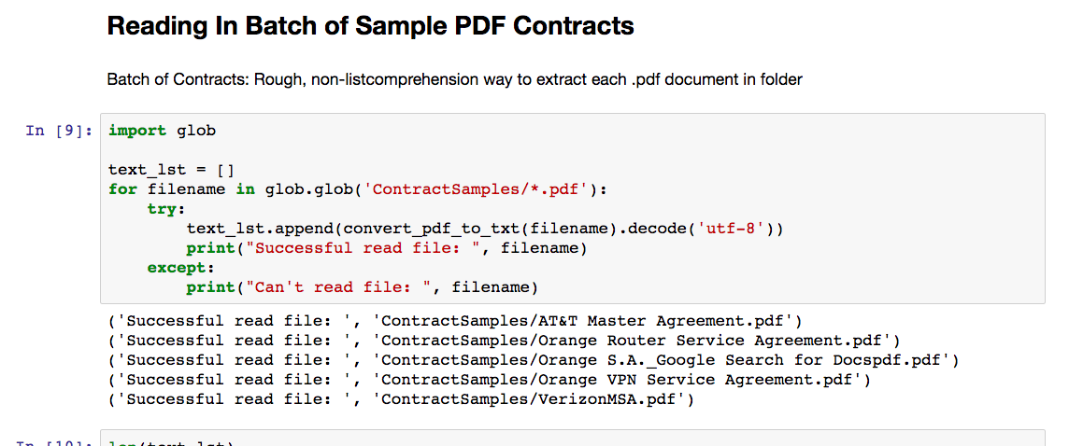
EXTRACTION – STEP 1
PDF FILE FORMAT:
SCANNER
or Software
Selections
for pdf

Slide 9
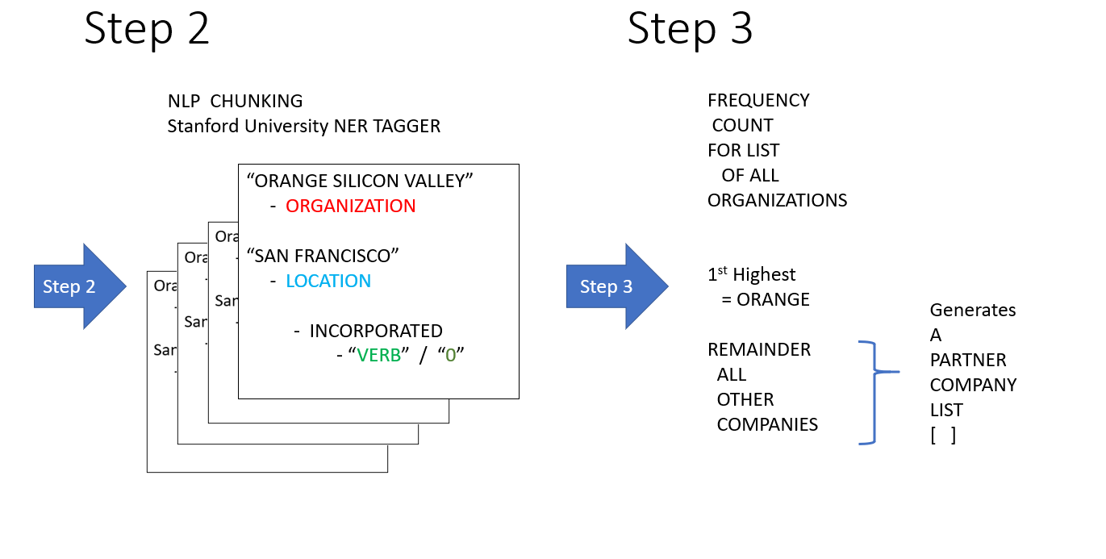
EXTRACTION – STEPS 2 & 3

Slide 10
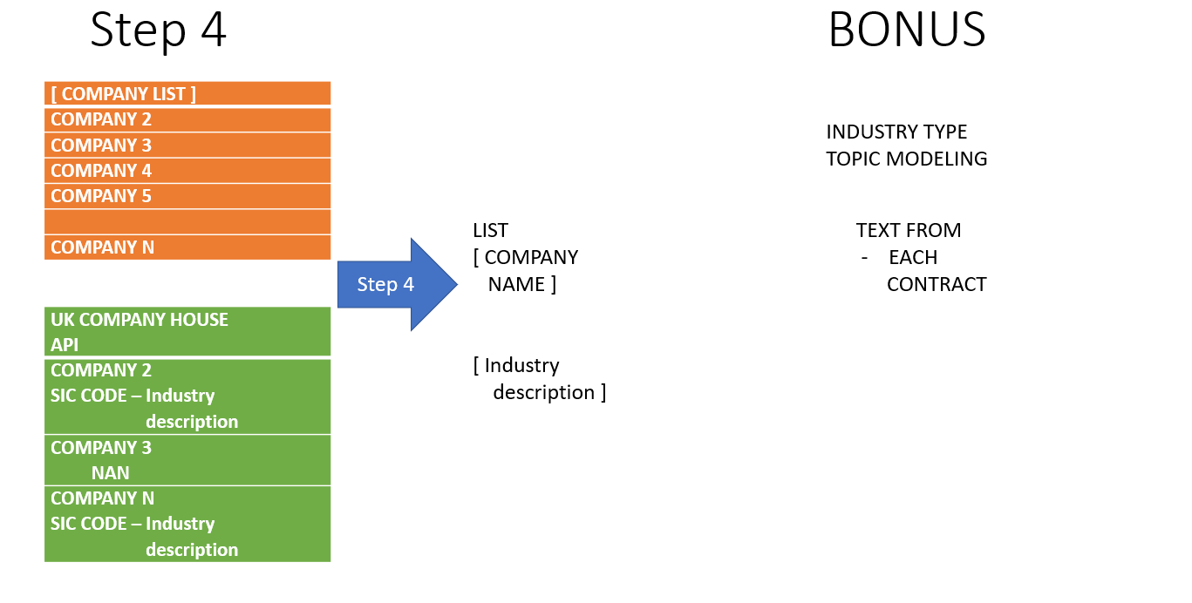
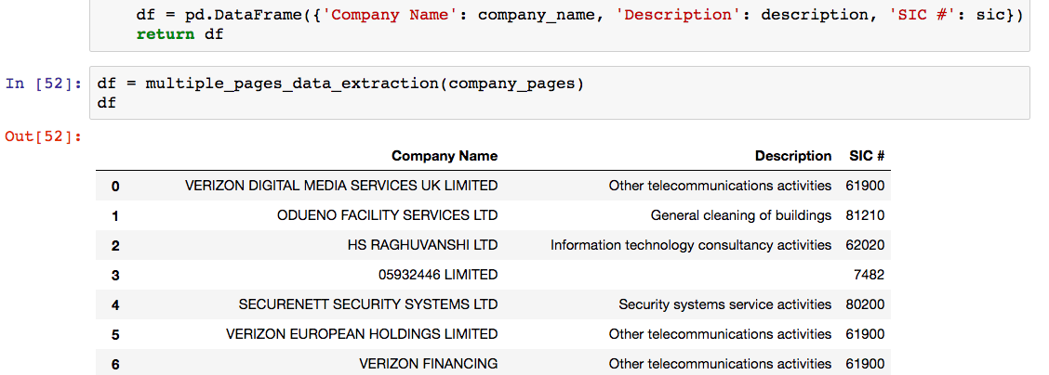
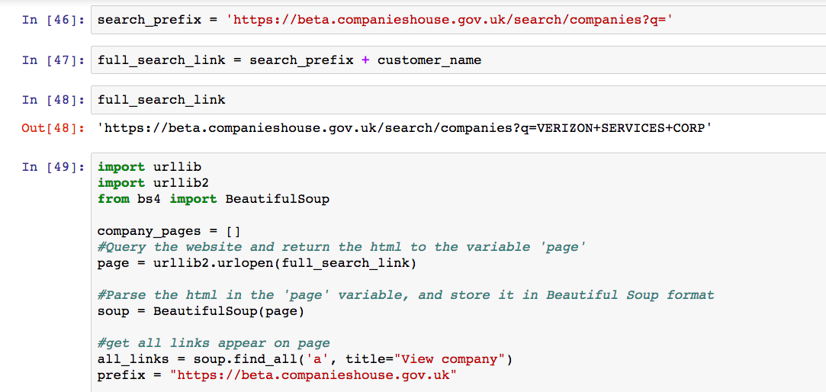
EXTRACTION – Steps 4+

Slide 11

Inherently Attributable encoding errors
RESULTS
60% extraction from Toy set:
End-to-end
K Partner Name, SIC,
& Industry description
10-15% text extracted from
firewalled corpus of 479 PDFMiner
successful conversions
legal beagle
Inked signatures & Sharpie redactions from pdfs = no meaningful extraction
Non-Adobe software conversions to pdf
consistent encoding errors with open
source PDFMiner tool

Slide 12
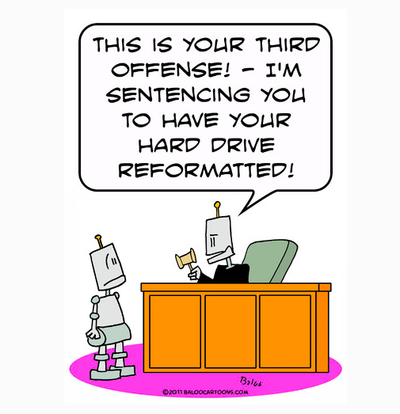
Conclusion
–LEARNED
– DEMONSTRATES PROCESS FOR DATA EXTRACTION, architecture for pre-structuring data, and processing of legal terminology – where meaning is not exacting
*Clause labels derived from manual comparison
–FUTURE with structured text from PDF contracts, can positively chart a course for
Machine Learning
Classification and Clustering
* -- address when drafting contracts: certain provisions and particular industries most at risk of deviation from the baselined-norm & adjust subsequent lawyer contract workflows early-on - - to avoid high costs and more billable time with contract creation

Slide 13

THANKS !
THANK YOU for your attention &
– Welcoming Your FEEDBACK –

